Slide 1
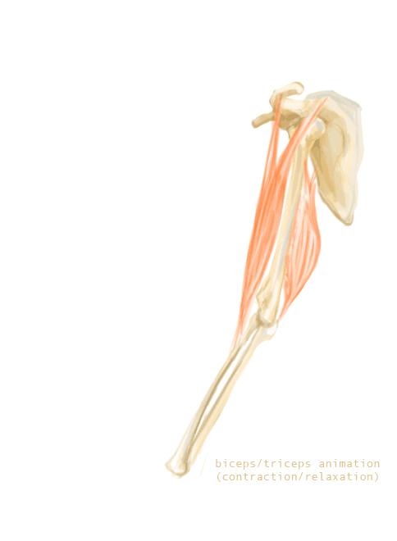
Muscles working together
AEHBY ATAR Human Biology

Slide 2
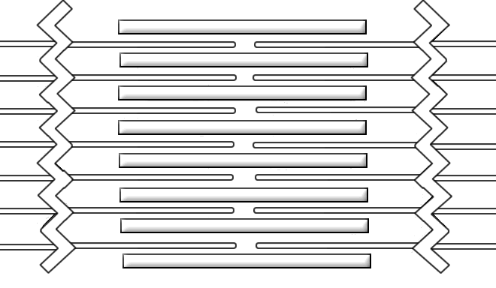
Review
Colour the actin blue.
Colour the myosin red.
Label the sarcomere.
Label the Z line (plate).
Label the I band and A band.
Draw and label the M line.
Label the H zone.

Slide 3
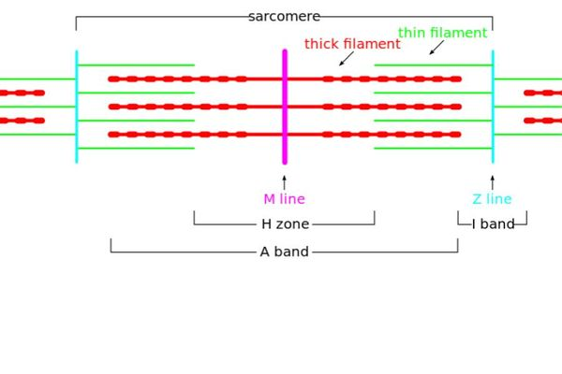

Slide 4
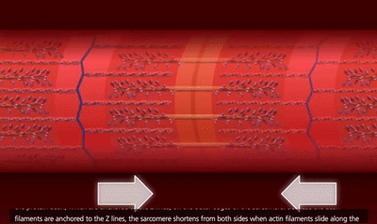
Learning Intentions
Movement results from the actions of paired muscles, with others acting as stabilisers, to produce the required movement.

Slide 5
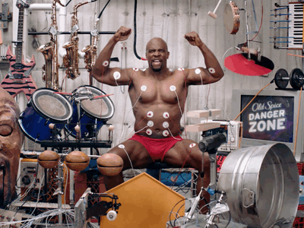
Success Criteria
Identify the origin and insertion of a muscle.
Distinguish between flexion and extension.
Define and identify agonist and antagonist and synergist.
Give examples of antagonistic pairs.

Slide 6
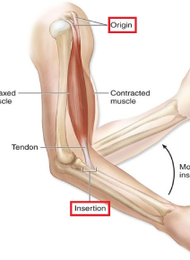
Muscles
Skeletal muscles allow bones to move around joints. Muscles are attached to the bone by tendons, at the insertion point on the moving bone, and at the origin on the non-moving bone.

Slide 7
Muscles in pairs
Since muscles can only contract, they can only pull bones (via tendons) but not push them. Pairs of muscles coordinate movement, with opposing actions. While the agonist (‘prime mover’) pulls, the antagonist relaxes to allow control over the motion.
Synergist muscles help to support or assist the prime mover or act as a stabiliser for the joint.

Slide 8
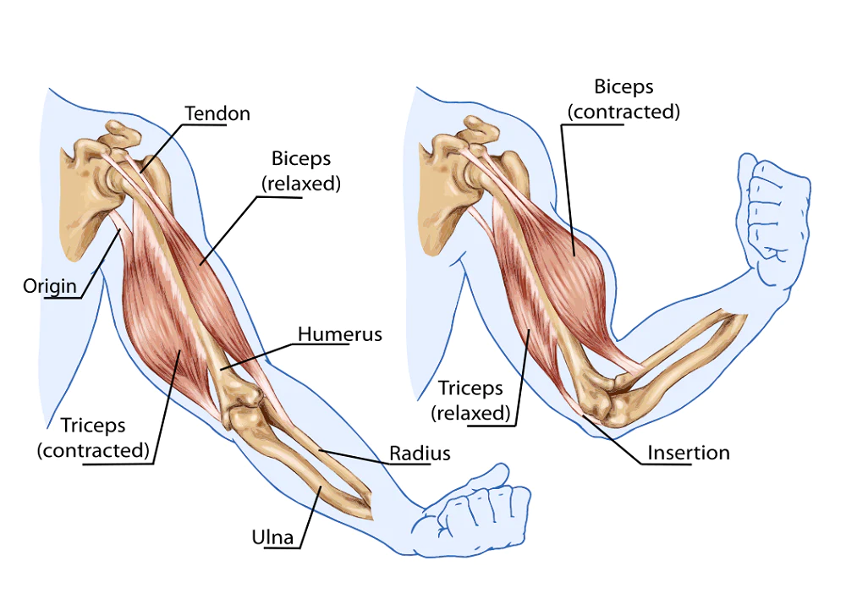

Slide 9
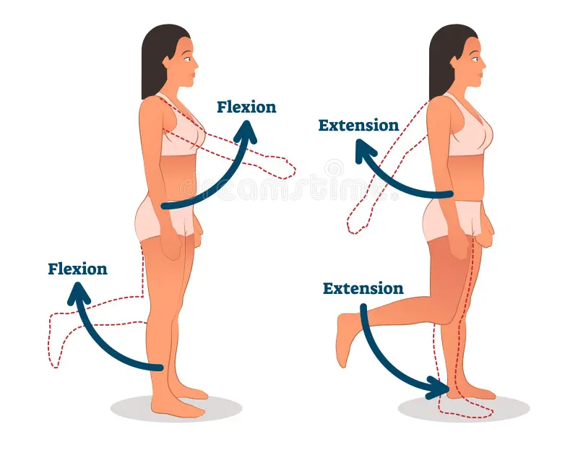
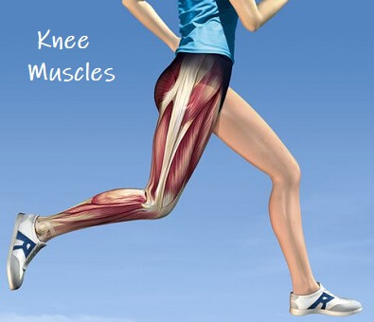
Flexion and extension

Slide 10
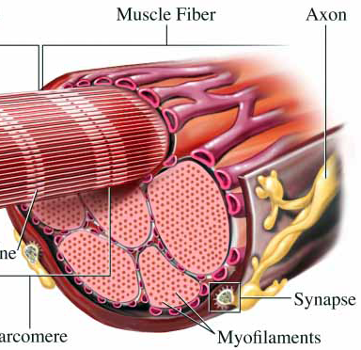
Muscle tone
Partial tension of muscles to maintain posture or body position is achieved by fibres within a muscle alternating their contraction and relaxation. This allows some fibres to ‘take turns’ resting so that positions can be maintained for long periods of time.

Slide 11
Success Criteria
Identify the origin and insertion of a muscle.
Distinguish between flexion and extension.
Define and identify agonist and antagonist and synergist.
Give examples of antagonistic pairs.

